Slide 1
LESSON 22

Slide 2
Overview
of
Previous Lesson(s)

Slide 3

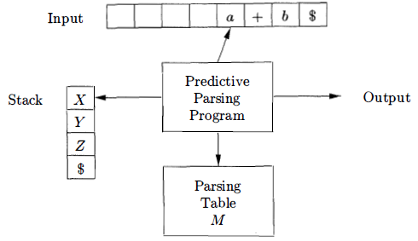
Over View
A non recursive predictive parser can be built by maintaining a stack explicitly, rather than implicitly via recursive calls.
If w is the input that has been matched so far, then the stack holds a sequence of grammar symbols α such that

Slide 4
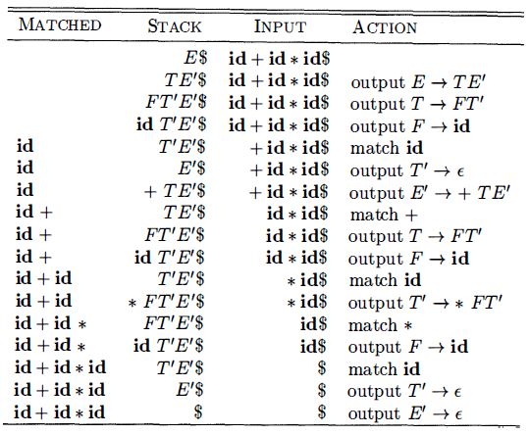
Over View..

Slide 5
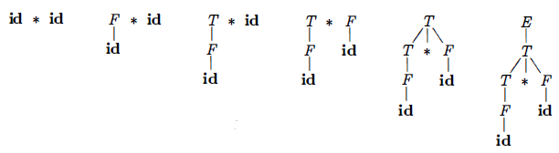
Over View…
Bottom-up parsing is the process of "reducing" a string w to the start symbol of the grammar.
A sequence of reductions are:
id * id, F * id, T * id, T * F, T, E
By definition, a reduction is the reverse of a step in a derivation

Slide 6
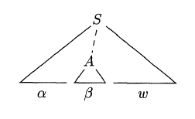
Over View…
Handles
if S ⇒* αAw then production A → β in the position following α is a handle of αAw
The string w to the right of the handle must contain only terminal symbols

Slide 7
Over View…
Four possible actions a shift-reduce parser can make: shift, reduce, accept, and error
Shift the next input symbol onto the top of the stack.
Reduce The right end of the string to be reduced must be at the top of the stack. Locate the left end of the string within the stack and decide with what non-terminal to replace the string.
Accept Announce successful completion of parsing.
Error Discover a syntax error and call an error recovery routine.

Slide 8
Over View…
LR(k) parsing
L is for left-to-right scanning of the input.
R is for constructing a rightmost derivation in reverse.
(k) represents the number of input symbols of look-ahead that are used in making parsing decisions.
When (k) is omitted, k is assumed to be 1

Slide 9
Over View…
Intuitively, for a grammar to be LR it is sufficient that a left-to-right shift-reduce parser be able to recognize handles of right-sentential forms when they appear on top of the stack.
LR parsing is attractive for a variety of reasons:
LR parsers can be constructed to recognize virtually all programming language constructs for which context-free grammars can be written.
The LR-parsing method is the most general non-backtracking shift-reduce parsing method known, yet it can be implemented as efficiently as other, more primitive shift-reduce methods

Slide 10
Over View…
An LR parser can detect a syntactic error as soon as it is possible to do so on a left-to-right scan of the input.
The class of grammars that can be parsed using LR methods is a proper superset of the class of grammars that can be parsed with predictive or LL methods.
The principal drawback of the LR method is that it is too much work to construct an LR parser by hand for a typical programming-language grammar.

Slide 11
Over View…
An LR parser makes shift-reduce decisions by maintaining states to keep track of where we are in a parse.
States represent sets of "items."
An LR(0) item of a grammar G is a production of G with a dot at some position of the body.
Thus, production A → XYZ yields the four items
A → ·XYZ
A → X ·YZ
A → XY· Z
A → XYZ·

Slide 12
Over View…
To construct the canonical LR(0) collection for a grammar, we define an augmented grammar and two functions, CLOSURE and GOTO
If G is a grammar with start symbol S, then G', the augmented grammar for G, is G with a new start symbol S' and production S' → S
The purpose of this new starting production is to indicate to the parser when it should stop parsing and announce acceptance of the input. That is, acceptance occurs when the parser is about to reduce by S' → S

Slide 13
Over View…
Closure of Item Sets
If I is a set of items for a grammar G, then CLOSURE(I) is the set of items constructed from I by the two rules:
Initially, add every item in I to CLOSURE(I)
If A → α·Bβ is in CLOSURE(I) and B → γ is a production, then add the item B → .γ to CLOSURE(I) if it is not already there. Apply this rule until no more new items can be added to CLOSURE(I)

Slide 14
Over View…
The Function GOTO
The second useful function is GOTO(I,X) where I is a set of items & X is a grammar symbol.
GOTO(I,X) is defined to be the closure of the set of all items [A → αX∙β] such that [A → α∙Xβ] is in I
Intuitively, the GOTO function is used to define the transitions in the LR(0) automaton for a grammar.
The states of the automaton correspond to sets of items, & GOTO(I,X) specifies the transition from the state for I under input X

Slide 15
TODAY’S LESSON

Slide 16
Contents
Introduction to LR Parsing
Why LR Parsers?
Items and the LR(0) Automaton
The LR-Parsing Algorithm
Constructing SLR-Parsing Tables
Viable Prefixes
Powerful LR Parsers
Canonical LR(l) Items
Constructing LR(l) Sets of Items
Canonical LR(l) Parsing Tables
Constructing LALR Parsing Tables
Efficient Construction of LALR Parsing Tables
Compaction of LR Parsing Tables

Slide 17
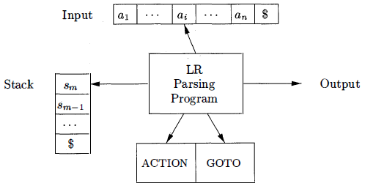
LR Parsing Algorithm
Model of an LR parser
It consists of an input an output a stack a parsing program & a parsing table that has two parts (ACTION and GOTO)

Slide 18
LR Parsing Algorithm..
The parsing program is the same for all LR parsers, only the parsing table changes from one parser to another.
It reads characters from an input buffer one at a time.
A shift-reduce parser would shift a symbol, an LR parser shifts a state.

Slide 19
LR Parsing Algorithm...
Structure of the LR Parsing Table
It consists of two parts: a parsing-action function ACTION and a goto function GOTO.
Given a state i and a terminal a or the end-marker $ ACTION[i,a] can be
Shift j The terminal a is shifted on to the stack and the parser enters state j.
Reduce A → α The parser reduces α on the TOS to A.
Accept
Error

Slide 20
LR Parsing Algorithm…
LR-Parser Configurations (formalism)
This formalism is useful for stating the actions of the parser precisely, but I believe the parser can be explained without this formalism.
The essential idea of the formalism is that the entire state of the parser can be represented by the vector of states on the stack and input symbols not yet processed.
A configuration of an LR parser is a pair:
(s₀,s₁...s_{m} , a_{i}a_{i+1}...a_{n}$)

Slide 21
LR Parsing Algorithm…
This state could also be represented by the right-sentential form
X₁...X_{m} , a_{i}...a_{n}
where the X is the symbol associated with the state.
All arcs into a state are labeled with this symbol.
The initial state has no symbol.
Behavior of the LR Parser
The parser consults the combined ACTION-GOTO table for its current state (TOS) and next input symbol, formally this is ACTION[s_{m},a_{i}] and it proceeds based on the value in the table.
If the action is a shift, the next state is clear from the DFA.

Slide 22
LR Parsing Algorithm…
The configurations resulting after each of the four types of move are as follows:
Shift s The input symbol is pushed and becomes the new state. The new configuration is(s₀...s_{m}s, a_{i+1}...a_{n})
Reduce A → α Let r be the number of symbols in the RHS of the production. The parser pops r items off the stack (backing up r states) and enters the state GOTO(s_{m-r},A). That is after backing up it goes where A says to go. A real parser would now probably do something, e.g., a semantic action.
Accept
Error

Slide 23
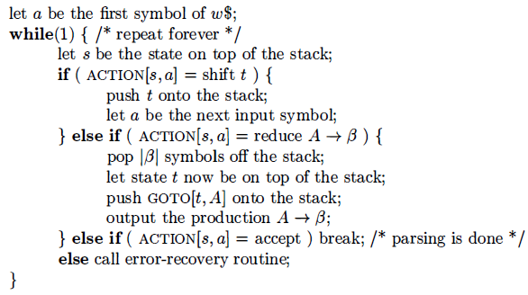
LR Parsing Algorithm…
INPUT: An input string w and an LR-parsing table with functions ACTION and GOTO for a grammar G.
OUTPUT: If w is in L(G), the reduction steps of a bottom-up parse for W, otherwise, an error indication.
METHOD: Initially, the parser has S₀ on its stack, where S₀ is the initial state, and w$ in the input buffer.

Slide 24
LR Parsing Algorithm…
In order to construct the ACTION table we need to know the FOLLOW sets, the same sets that we constructed for top-down parsing.
The codes for the actions are:
s_{i} means shift and stack state i,
r_{j} means reduce by the production numbered j ,
acc means accept,
blank means error.

Slide 25
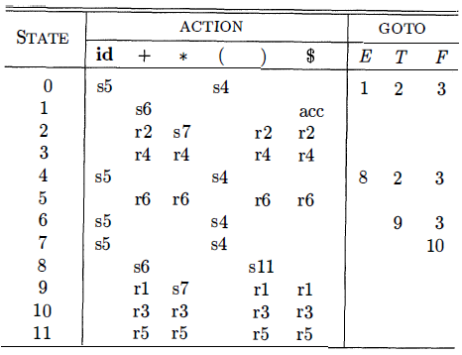
LR Parsing Algorithm…
Parsing table for the Ex Grammar G
Grammar G
E → E + T 4. T → F
E → T 5. F → ( E )
T → T * F 6. F → id

Slide 26
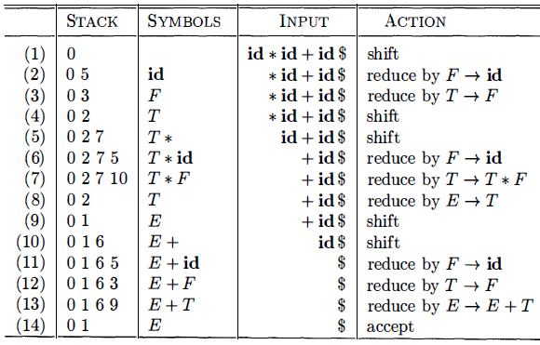
LR Parsing Algorithm…
On input id * id + id the sequence of stack and input contents are:

Slide 27
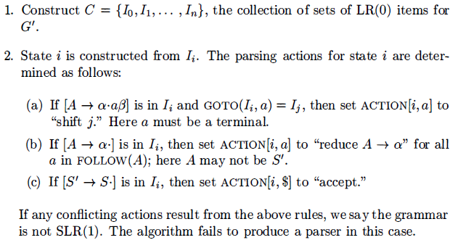
Constructing SLR-Parsing Tables
SLR Parsing Table
The SLR method begins with LR(0) items and LR(0) automata.
INPUT: An augmented grammar G‘
OUTPUT: The SLR-parsing table functions ACTION and GOTO for G’
METHOD:

Slide 28
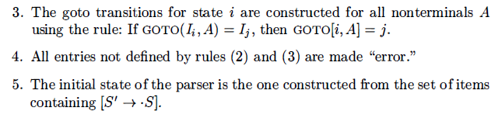
Constructing SLR-Parsing Tables..
Ex: Now we construct the SLR table for the augmented expression grammar.
The canonical collection of sets of LR(0) items for the grammar are the same as we saw in last lesson.

Slide 29
Constructing SLR-Parsing Table…
First consider the set of items I₀ :
E‘ → ∙E
E → ∙E + T | ∙T
T → ∙T * F | ∙F
F → ∙(E) | ∙id
The item F → ∙(E) gives rise to the entry ACTION[0,(] = shift 4
The item F → ∙id to the entry ACTION [0,id] = shift 5
Other items in I₀ yield no actions.

Slide 30
Constructing SLR-Parsing Tables...
Now consider I₁
E‘ → ∙E
E → E∙ + T
The 1st item yields ACTION[1,$] = accept
The 2nd item yields ACTION[1,+] = shift 6
For I₂
E → T∙
T → T∙ * F
Since FOLLOW(E) = {$, +, )} the 1st item yields ACTION[2,$] = ACTION[2,+] = ACTION[2,)] = reduce E → T
2nd item yields ACTION[2,*] = shift 7
Continuing in this fashion we obtain the ACTION and GOTO tables

Slide 31
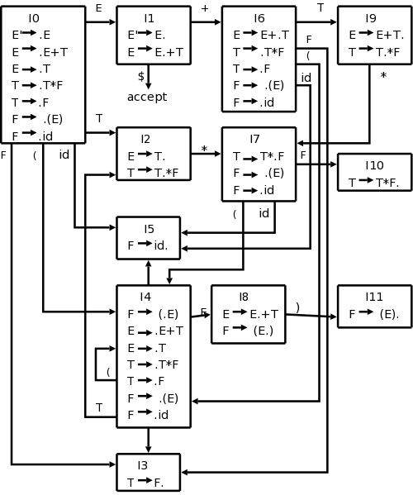
Constructing SLR-Parsing Tables...
First consider the set of items I₀ :
E‘ → ∙E
E → ∙E + T | ∙T
T → ∙T * F | ∙F
F → ∙(E) | ∙id
The item F → ∙(E) gives rise to the entry ACTION[0,(] = shift 4
The item F → ∙id to the entry ACTION [0,id] = shift 5
Other items in I₀ yield no actions.

Slide 32
Thank You

